Slide 1

CMS-2000
Central Management System
QNAP Security
Notes:
這個 簡報示範 PowerPoint 的新功能，而且使用投影片放映來檢視的效果最佳。這些投影片是為了讓您瞭解，使用 PowerPoint 2010 可以讓您建立出多棒的簡報!
如需更多範例範本，請按一下 [檔案] 索引標籤，然後在 [新增] 索引標籤上按一下 [範例範本]。

Slide 2

1
2
3
Product Comparison
Surveillance Total Solution
(Framework)
Product Features
QNAP Fit your need

Slide 3

1
Product Comparison
QNAP Fit your need

Slide 4
QNAP Surveillance Product Comparison
 | Local Display | IE browser | CMS
Number of Channels Supported (Live View) | 48 | 128 | 64~1024
Number of Channels can be Viewed Simultaneously (Maximum Channels in a Layout) | 12 | 42 | 64
Number of Maximum Concurrent Connection | 1 | 5 | 16 (under test)
Applicable Site | SOHO/Small and Medium Busines | Small and Medium Business | Enterprise/Large Site
Feature | Flexibility of Deployment | Remote Monitoring | Privilege Management

Slide 5
Surveillance Total Solution (Framework)
2
QNAP Fit your need

Slide 6












QNAP Surveillance Total Solution (Framework)
Monitor Centre
Video Wall
Control Centre
NVR
Recording Storage
Video Wall Workstation
CMS Workstation
CMS-2000
Secondary Control Centre(1)
Secondary Control Centre(2)
Local LAN
Monitoring Centre
Video Wall Workstation
Video Wall Control Centre
Chain Store
Corporation
Office
Factory

Slide 7
3
Product Features
QNAP Fit your need

Slide 8
Product Features
Turnkey Solution
System Dashboard
Multi-Monitor Mode
E-map/View Layout Shortcut
Alarm Mode
Multi-Layer E-map/View Layout
Bookmark (Live View/Playback)
Video Wall Solution
User/Privilege Management (Role/Group)
1+x View Layout

Slide 9

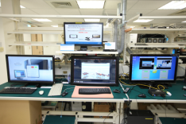
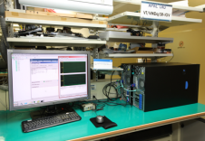
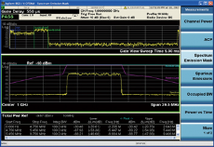
Turnkey Solution
QNAP have professional Hardware /Software/ Testing RD team

Slide 10
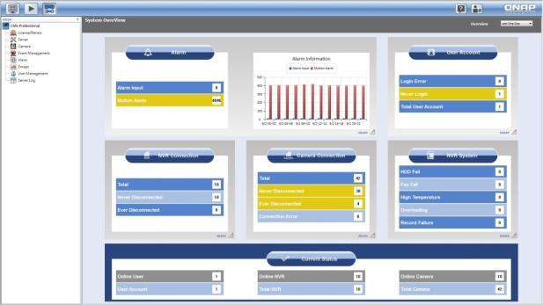
System Dashboard
Watch all information at a glance, keep everything under control.
Current User/NVR/Camera information, gives administrator a thorough understanding of whole system.
Providing 1/3/7 days of system information, facilitates administrator to analyze and react to any event.
Clear statistical charts focuses administrator on every critical moment
Sections of historical information, helps administrator to track and solve problems.

Slide 11
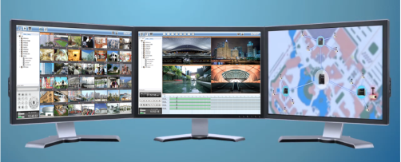
Multi-Monitor Mode
Support 4 monitors of main screen (configuration and playback included), E-map, and live view.
Easily modifying particular use of each monitor: E-map, and live view.
Main screen: System Configuration, E-map, live view, alarm list and event log, playback, bookmark, PTZ and camera control, and etc.
E-map screen: Multi-layer E-map, camera position indication, instant notifications of events
Live view screen: Supporting up to 64-channel display simultaneously with 15 styles of view layout.

Slide 12
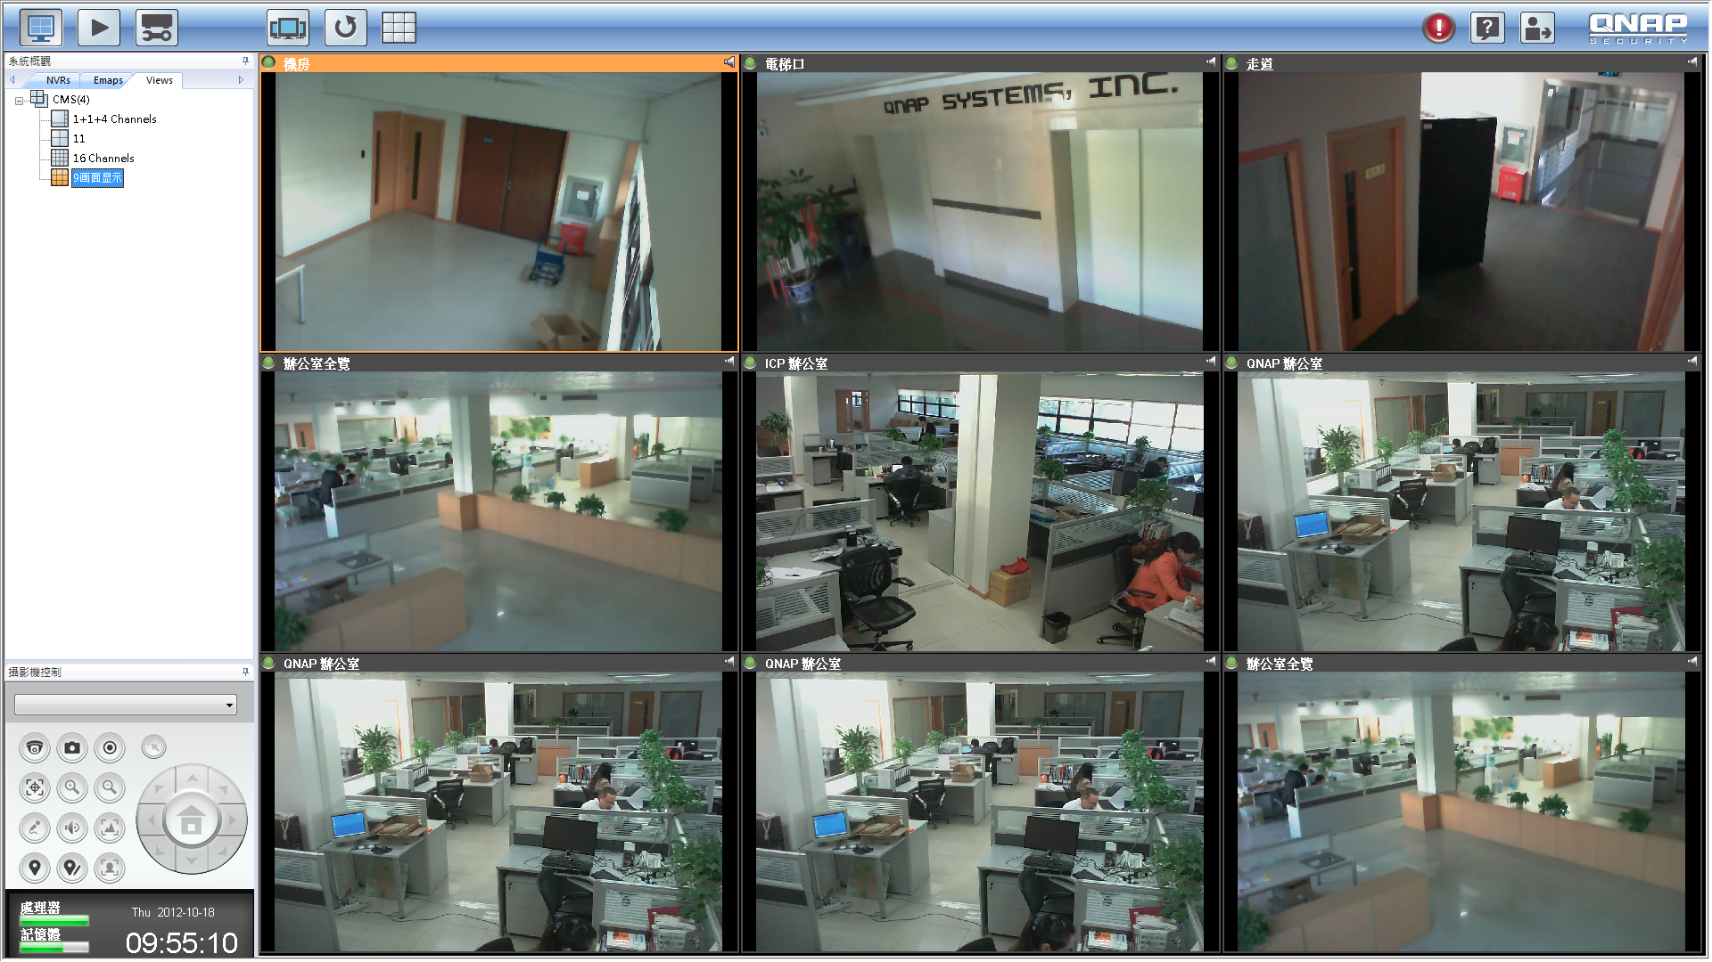
E-map/View Layout Shortcut
Shortcut: Drag E-map or View Layout of priority watch onto the toolbar, and click whenever you need to.

Slide 13
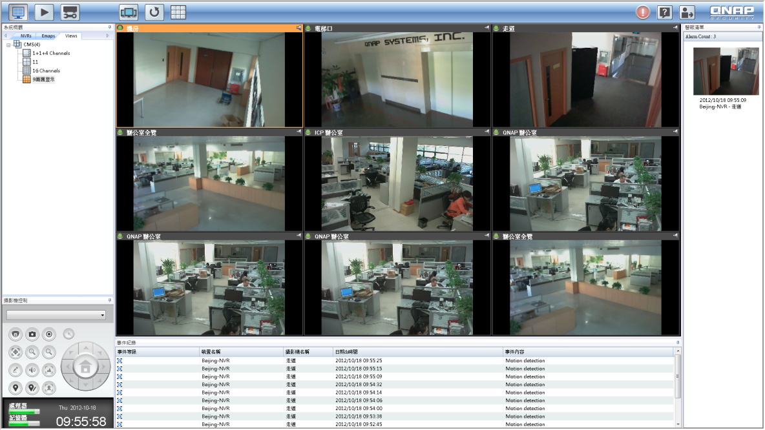
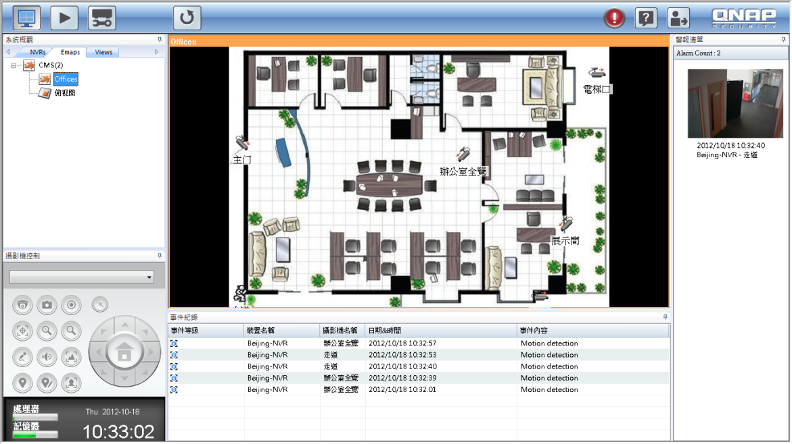
Alarm Mode
Alarm mode: Providing snapshot, log, and instant handling of
alarm-triggered camera
1. Pop out the live view of camera
2. Switch to the view layout of camera
3. Switch to the E-map of camera
4. Instantly playback each 15 seconds before and after the alarm occurs

Slide 14
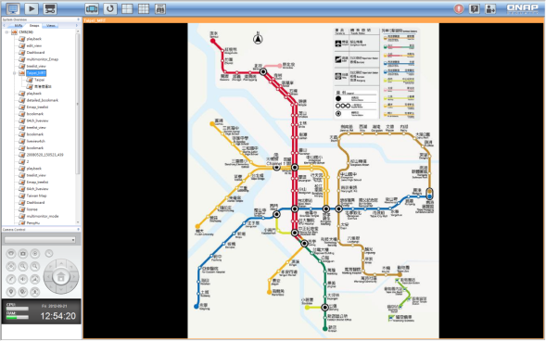
Multi-Layer E-map
Layers of E-map indicates administrator connections of each E-map
Define relative positions on E-map and pop-out up to 5 live-view windows of cameras
Obvious alarm icon notifies administrator to handle the security issue.

Slide 15
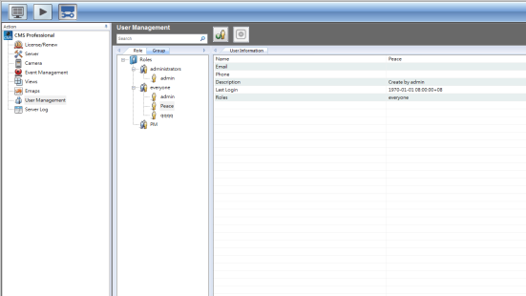
User/Privilege Management
Offering complete authority management. Different user levels, access rights, and permissions.
Defining every user of his role and group, and construct a hierarchy of all system users
Role defines user’s capability to see and to configure, and group only classifies user by information.

Slide 16
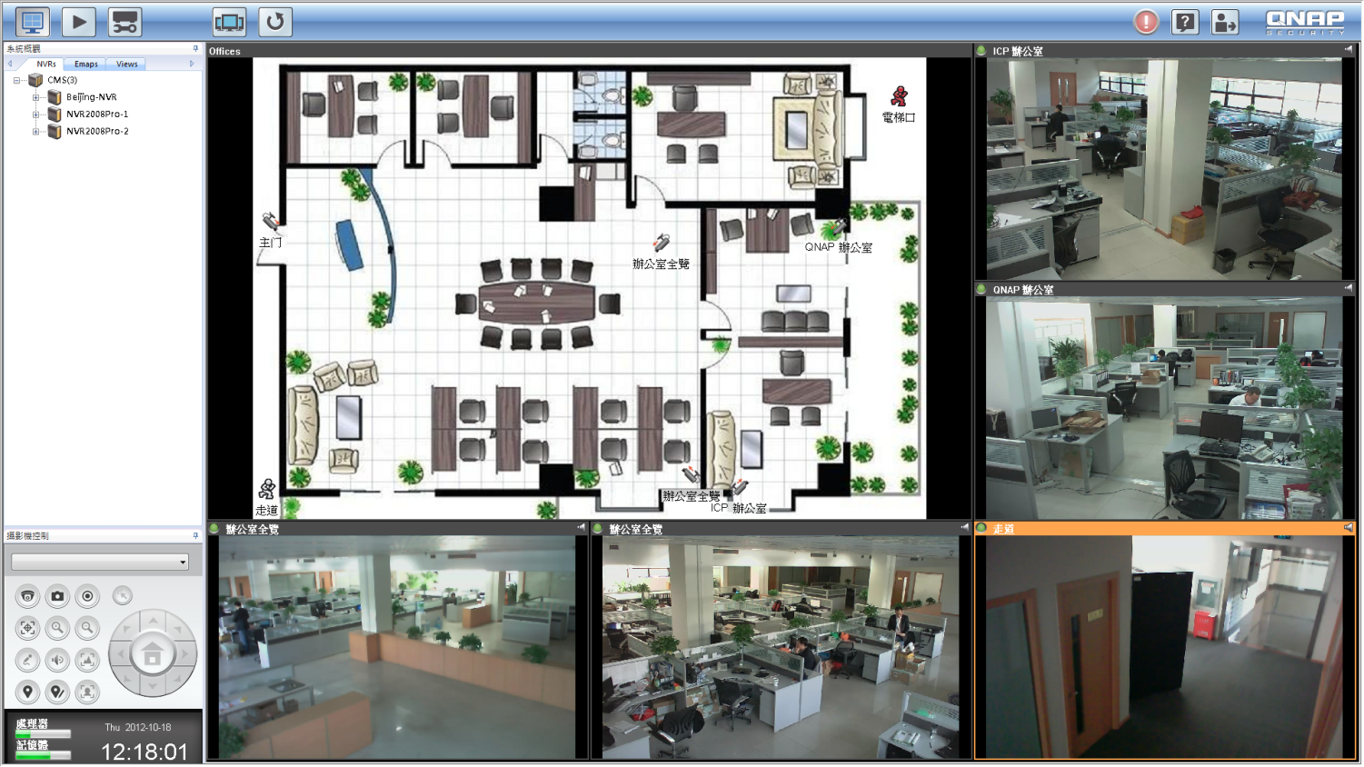
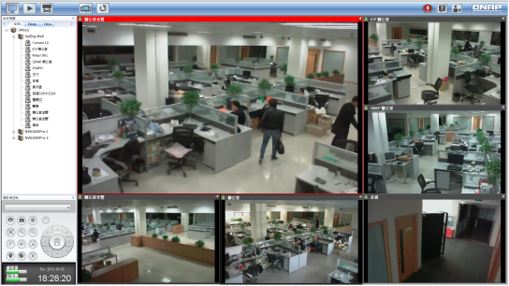
1+x View Layout
Insert a E-map into a 1+x Layout , arrange all side-channel cameras into the E-map , and you can organize corresponding floor plans.
Predefine a key region to monitor and put it in the main channel of 1+x layout.
Fix the critical section camera in main channel ,while you can set side-channel cameras into sequential mode.

Slide 17
插入動畫
?
QNAP Fit your need

Slide 18
Q&A

