Slide 1


Slide 2

Company Overview
Founded on February 8, 2000
Chairman: Owen Chen
CEO: Eddy Lan
Capital: $22M USD
Address: Chung-ho, New Taipei City, Taiwan
Branch office: San Jose, California, USA (established in 2008)
Number of employees: 400 (HQ); 25 (USA)
IPO: July 2006
Subsidiary: VATICS (www.vatics.com) (established in 2007)
Notes:
2

Slide 3
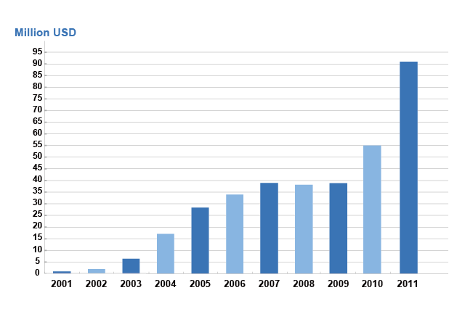

Sales Performance
Profitable and continues to grow
Listed on Taiwan Stock Exchange in 2006
100% IP surveillance
Notes:
3

Slide 4
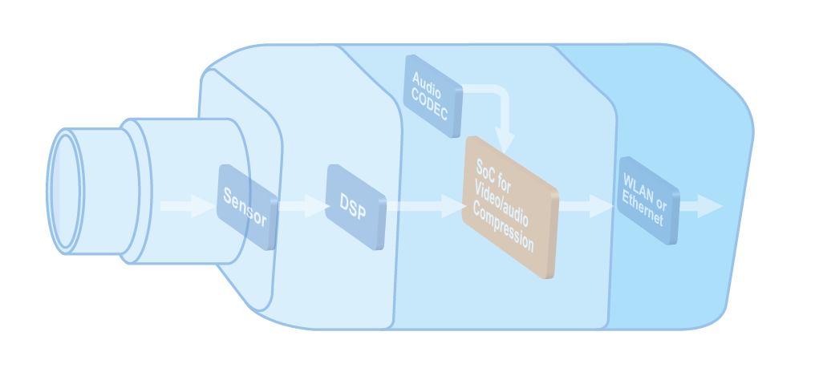
Technology
Embedded
System
Development
(SoC)
Network
Protocol
Optical
Technology
ME & EE Integration
In-house image tuning for sensor/lens/front-end
In-house AWB/AE/AGC
Tight cooperation with lens/sensor vendors
VATICS in-house designed SoC
In-house designed OS and framework
Core level customization for special project request
World’s first in 3GPP compliance
Full range of protocols for heterogeneous
networks
ONVIF/PSIA compliance

Slide 5



Channel Value Chain
Semiconductor
Manufacturers
Software &
Analytics
Camera & Peripheral Manufacturers
Authorized Distributors
Security Dealers
Telecom
System Integrators
End-Customers
Commercial
Residential
Industrial
Government
Notes:
5
5

Slide 6
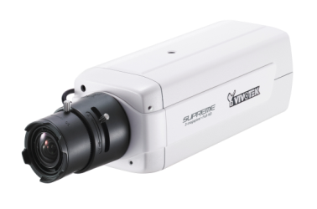
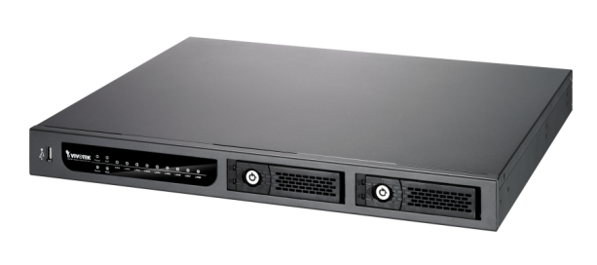
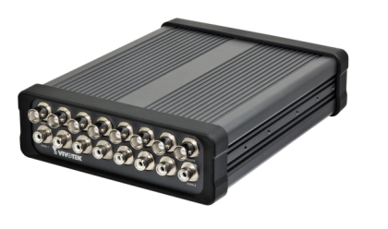
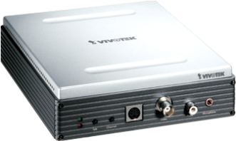
Comprehensive Product Line
Network
Cameras
Video
Servers
Video
Receivers
Network
Video
Recorders
Central
Management
System

Slide 7





Quality Assurance
Reliability and Environmental Testing
Cold Test
Dry Heat Test
Damp Heat Test
Temperature Cycling Test
Thermal Shock Test
Package Vibration Test
Package Drop Test
Package Storage Test
Endurance Test
MTBF (Mean Time Between Failures)
Quality Systems
ISO 14001
Certification
Since 2005
TL 9000
Certification
Since 2005
WEEE
Since 2006
RoHS
Since 2006
IECQ HSPM QC 080000 Since 2008
Notes:
7

Slide 8









Awards
Company
Industry Elite
By A&S
The 16th Taiwan SMEA "National Outstanding SMEs Award"
The 10th Taiwan SMEA "Rising Star Award"
Industrial Technology Advancement Award-Excellent Award
I.T. Month
Outstanding I.T. Elite Award
Security 50
2006~2011
Technology Fast 500 Asia Pacific 2007 by Deloitte & Touche
Technology Fast 500 Asia 2006 by Deloitte & Touche
Technology Fast 50 Taiwan 2006 by Deloitte & Touche

Slide 9










More Awards
Products
Symbol of
Excellence Winner
FE8171V, FD8134, IP8151
  CPS Top 10 Innovative Security Product Award
  IP7142、IP7151、SD7151
  GIT Security Award 2009
  IP7142
Outstanding I.T. Product Award
FE8171V, PZ7151/7152,
PT7135/7137
  SecuTech
  Award 2008
  PZ7151/7152
The 14th Taiwan "SMEs Innovation Award"
IP7138/7139
SecuTech
Award 2011
IP8162P
Symbol of
Excellence Winner
IP7138/7139
Best of Taiwan's
Best Award Winner
IP7135/IP7137
SecuTech
Award 2007
IP7138/7139
Symbol of
Excellence Winner
PT7135/7137
IP7135/7137
Best Choice of
COMPUTEX TAIPEI
PZ6112/PZ6122
Best of Taiwan
Best Award Winner
PZ6112/PZ6122
Symbol of
Excellence Winner
PT31X3/PT31X4
SecuTech
Award
PT3114
PC weekly
Recommend
PT3124
Personal
Computer Magazine
PT3124
Notes:
9

Slide 10

Sales Distribution
APAC12%
North
America 21%
EMEA 51%
LATAM 16%
Data source:
VIVOTEK Brand Sales Department 2011
Notes:
10

Slide 11
Extensive Distribution Channels
We have exported products to over 80 countries through a wide network of distributors – more than 150 authorized distributors worldwide. 20% of them have been working with VIVOTEK for over 5 to 9 years.
Repair Center
Netherland
VIVOTEK USA
VIVOTEK
(Taiwan HQ)

Slide 12


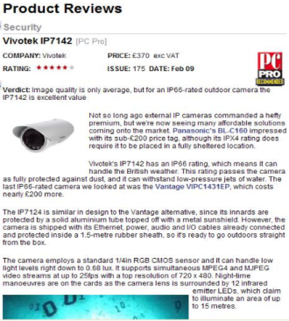





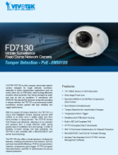
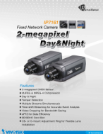
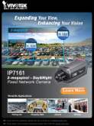
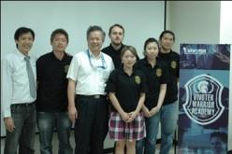
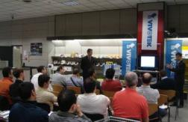
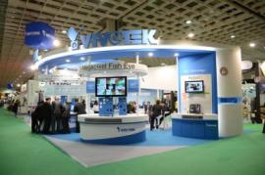
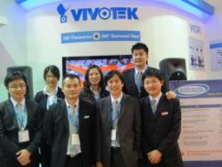

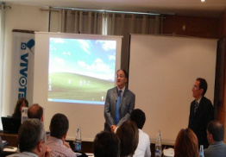
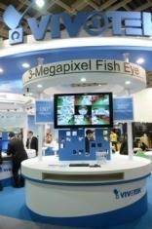

Integrated Branding Strategies
Awards
E-Marketing
PR/
Media
Marketing
Material
Road
Shows
Trade
Shows
Notes:
12

Slide 13


Solution Integration Alliance
Notes:
13

Slide 14

VIVOTEK Presales Team
Solution
Center
Project
Center
Vertical
Mkt Center
Solution partner sourcing & alliance
Solution pack
Project support
Key SI retain & presale
Vertical market development
Focus marketing
Notes:
Bolida team devotes to enhancing VIVOTEK's partnership and problem-solving efficiency as well as developing the project and vertical markets.
Solution Center will be responsible for partnership maintenance and enhancement through closer hardware and software integration.
Project Center will explore new project opportunities and provide necessary support to facilitate project completion.
Vertical Mkt Center will concentrate on enhancing VIVOTEK's presence in vertical markets.

Slide 15


VIVOTEK Presales Team
What makes us special!
Disty
RD
Technical
support
System
Integrators
Disty
System
Integrators
End Users
End Users

Slide 16
VIVOTEK Product Family
SUPREME
Value
Commercial
Enterprise Segment
Supreme Night View Quality
Complete Function and Specification of
Camera for Tender
Mid Range Level
General Surveillance Function
Aggressive Price/Solid Product
SMB/Retail Segment
Cost Driven Solution
IT Distribution Product

Slide 17
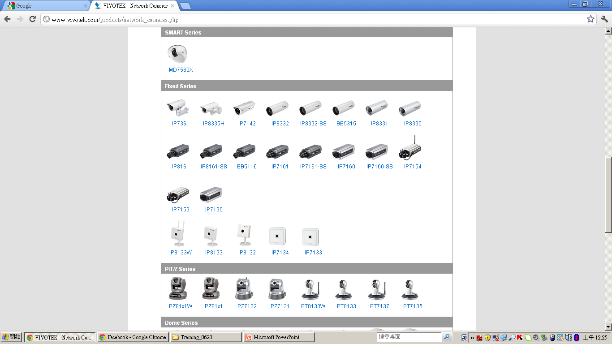
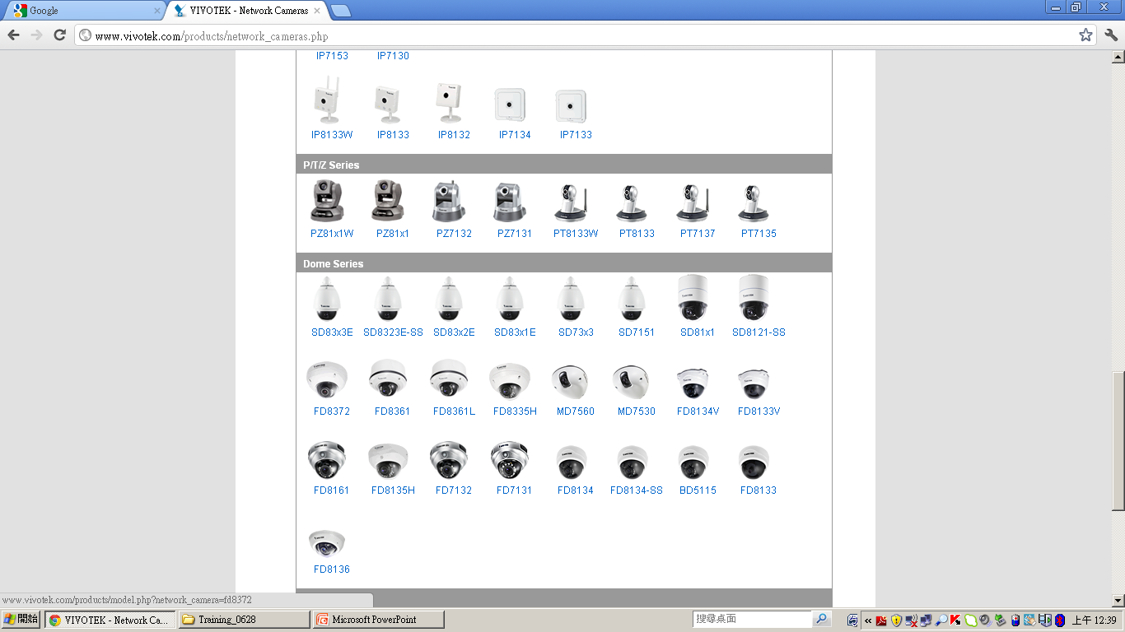
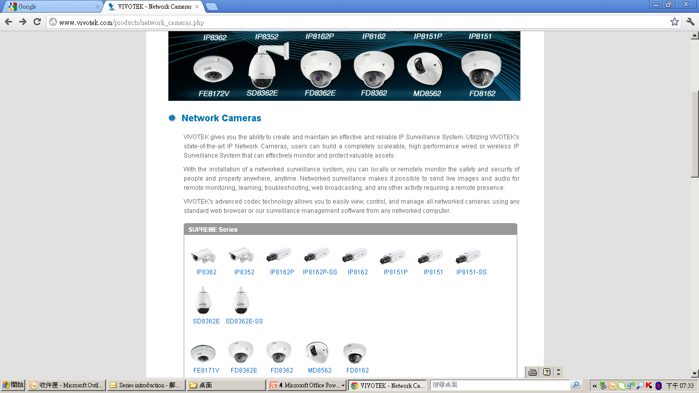
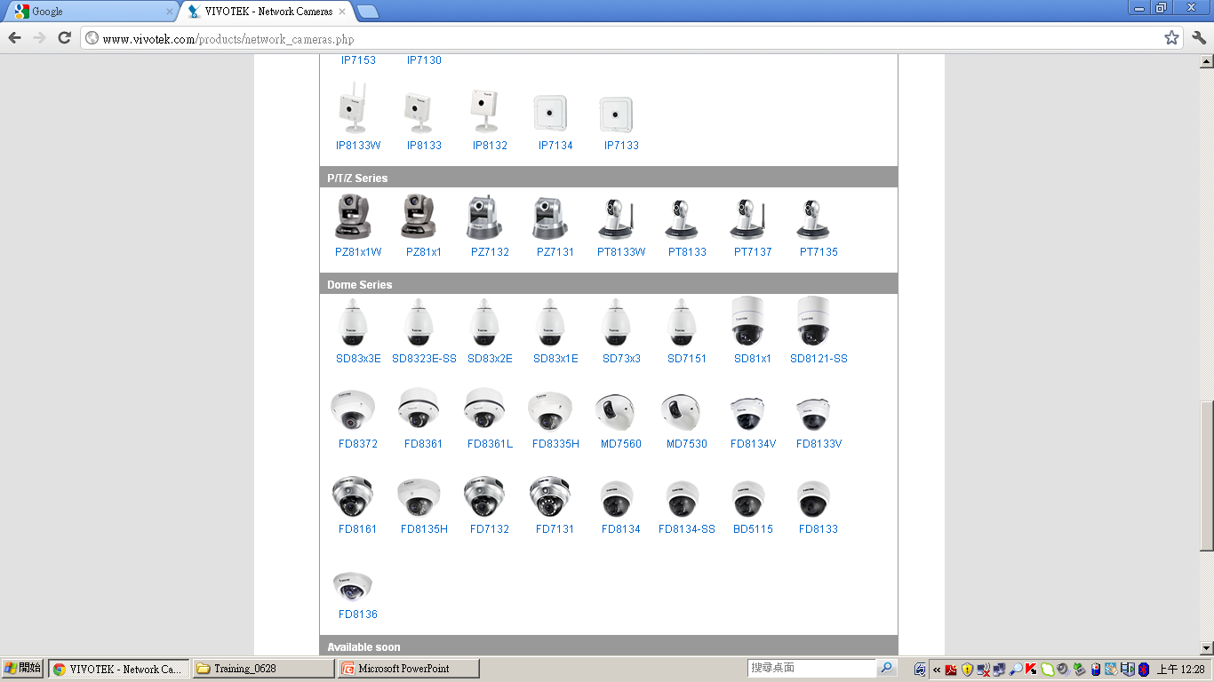
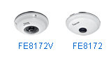
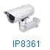








VIVOTEK Product Position
COMMERICAL
VALUE
SUPREME
SMB
Mid range
High End-Enterprise
Strategic
Players
Notes:
Supreme
FE8171V: 3MP Fisheye Dome
IP8362: 2MP/1080p Outdoor Bullet
SD8362E: 2MP/1080p 20x Zoom Outdoor Speed Dome
Value
IP8335H: 1MP WDR Outdoor Bullet
FD8161: 2MP Indoor Fixed Dome
SD8323E: D1 36x Zoom Outdoor Speed Dome
Commercial
IP8332: 1MP Outdoor Small Bullet
FD8134: 1MP Indoor Fixed Dome
IP8133: 1MP Cube Camera

Slide 18
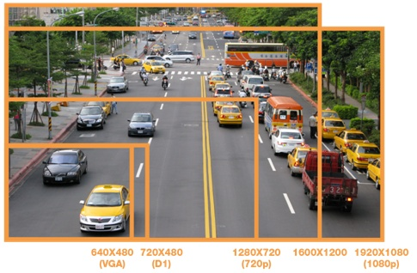
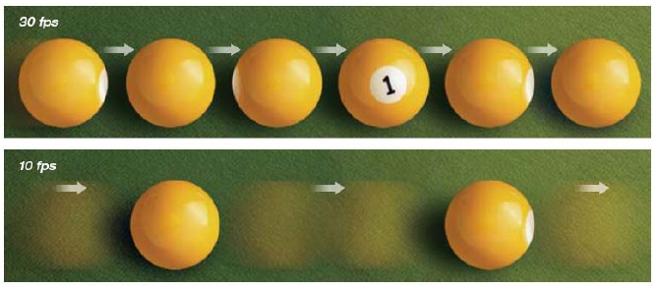
Complete Megapixel Solution
VGA | D1 | 1M (HD) | 1.3M | 2M (Full HD) | 3M | 5M
640 x 480 | 720 x 480 | 1280 x 800 | 1280 x 1024 | 1920 x 1080 | 2048 x 1536 | 2560 x 1960
10 fps | 15 fps | 30 fps | 60 fps

Slide 19
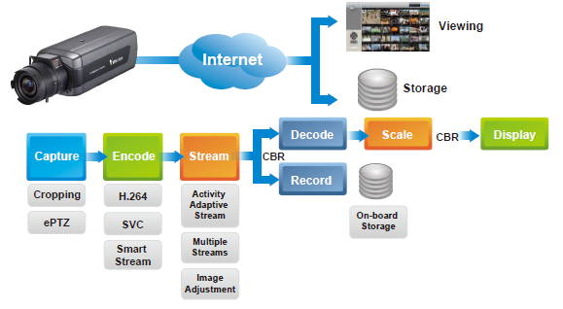
Smart Bandwidth Knowledge
VIVOTEK megapixel surveillance solution with powerful bandwidth and CPU management capabilities.

Slide 20
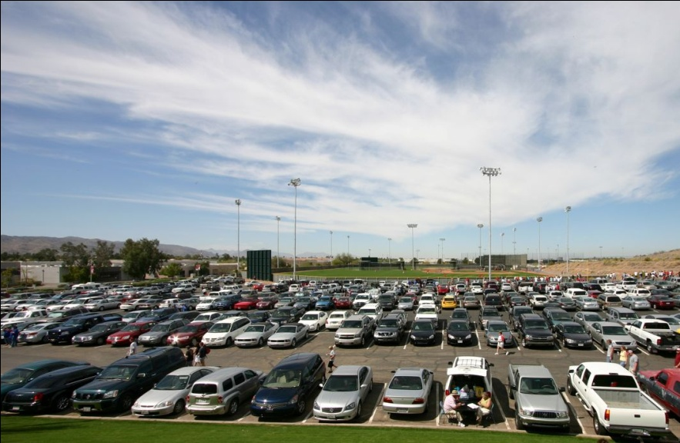

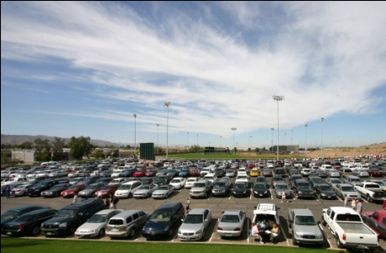
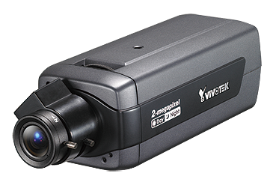
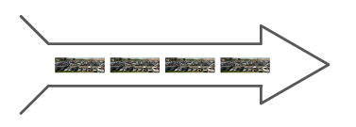
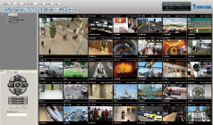

Cropping
Cropping
Removing unnecessary information before transmission
Cropped Image
Megapixel Camera
Transmit
Viewing & Storage

Slide 21


ePTZ
ePan & eTilt
eZoom +/-
Megapixel resolution over VGA bandwidth

Slide 22
H.264 Compression
by File Size
Compressed File Size
H.264
1%
MPEG-4
2%
20%
MJPEG
0 1 2 20 100%
H.264 provides with smaller bandwidth at the same quality

Slide 23



On-board Storage
Generic scenario with remote storage
Capturing
Transmitting
Storage
Advanced scenario with on-board storage
Transmitting
Storage
Capturing
On-board
Storage

Slide 24








Activity Adaptive Streaming
High
Low
High
High
Low
High
Low
Low
Bandwidth
Bandwidth
Bandwidth
Bandwidth
Frame
Frame
Frame
Frame
Frame
Frame
Frame
Frame

Slide 25
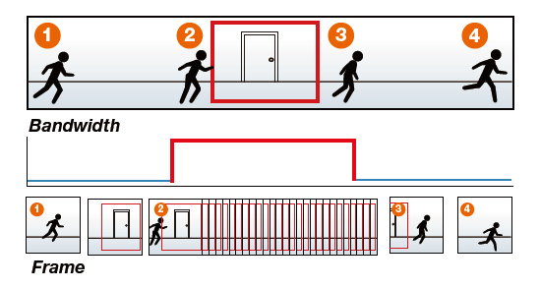
Activity Adaptive Streaming
Activity Adaptive Streaming for Optimal Bandwidth and Storage Efficiency
Activity Adaptive Streaming can optimize bandwidth usage during monitoring and ensure superior image quality during recording.
IP7161
Frame Size: 1600x1200
Frame Rate: 10 FPS
I-Frame Period: 1 S
Fixed Quality: Good
Bandwidth:
Active Period: about 400~600 KB/S
Inactive Period: about 80~100 KB/S
Recording Storage:
Full Frames: about 50 GB/Day
Enable Activity Adaptive Streaming:
about 8.5 GB/Day (No Event)
about 12 GB/Day (1 Event Every 5 Minutes)
Notes:
In this section,
in the picture, there is a frame. if the intruder intrudes the area of frame, that triggers recording. when it triggers recording, it composes an event with full frames from the camera from the start to the end of the triggered time period. Others than this time period, the recording frames remains 1 frame per second. In that way, it takes low bandwidth and saves a lot of storage space for use. So the user will save a lot of bandwidth fee and storage cost. Below is the example for this advantage. It shows the our test result approved our activity adaptive streaming works efficiently.
(explain the description of the example)

Slide 26

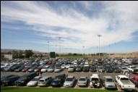

Multiple Streams
CIF
CIF for Viewing
Decoding
Displaying
2MP
2MP for Storage
Recording
Storage
Decreasing your CPU loading
Flexibility in viewing with small images and storing with large images

Slide 27
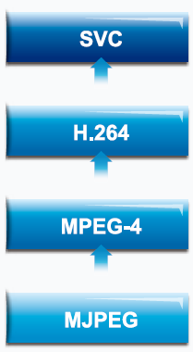
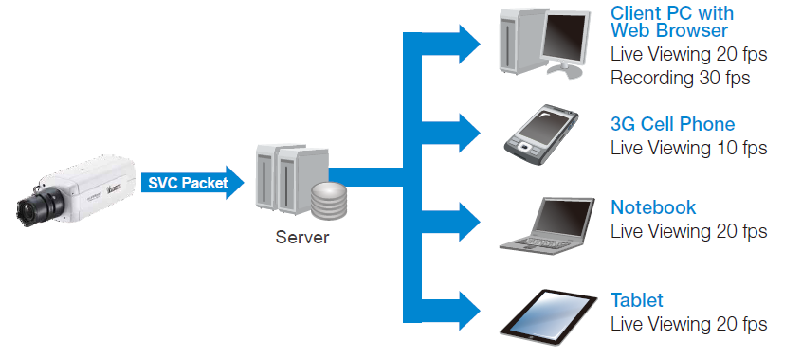
SVC
Scalable Video Coding

Slide 28
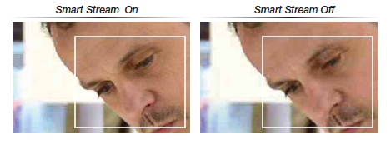
Smart Stream
10 FPS
10 FPS
30 FPS
10 FPS

Slide 29



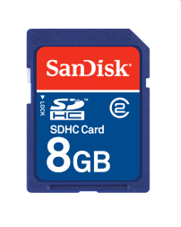
Seamless Recording
Servidor
Red
Grabación

Slide 30
Seamless Recording
Servidor
Red
MOD streaming
Grabación
MOD: Media on Demand

Slide 31
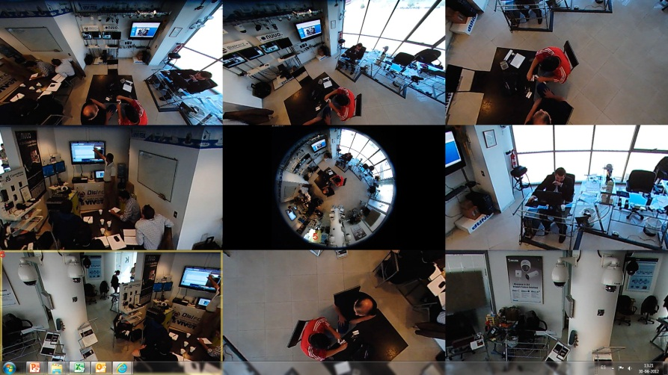
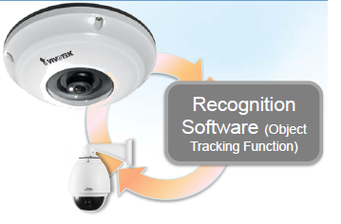
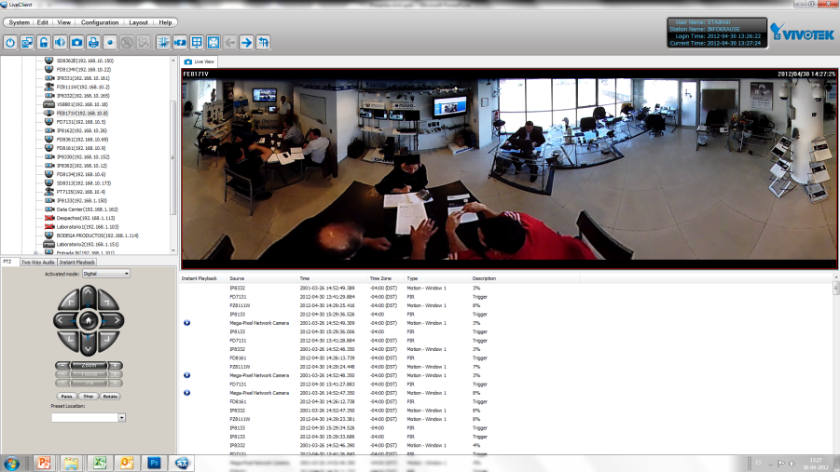
Truly 360ºC Panoramic Surveillance
FE8171V + SD8362E
Resolution 3M
View 180° & 360°
Anti Vandal
IP66
Resolution Full HD
20x Zoom
WDR
IP66

Slide 32

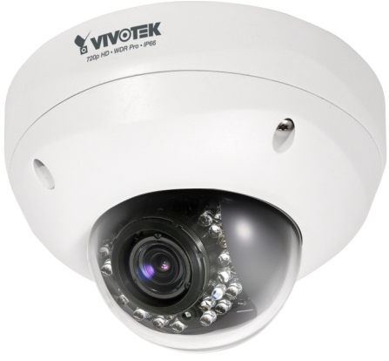
Product Feature & Benefits
Application Highlight
Product Comparison
Product Information
FD8372
Notes:
32

Slide 33
Product Features
5-Megapixel CMOS Sensor (30 fps @ 1080p HD)
Smart Focus System for Remote and Precise Focus Adjustment
f=3.6 ~ 9 mm Vari-focal, DC-iris Lens
Removable IR-cut Filter for Day & Night Function
Built-in IR Illuminators, Effective up to 20 Meters
Three D/I and one D/O for external sensor and alarm
Real-time H.264, MPEG-4, and MJPEG Compression (Triple Codec)
Built-in 802.3af Compliant PoE
Built-in MicroSD/SDHC/SCXC Card Slot for On-board Storage
FD8372
Notes:
33

Slide 34

5-Megapixel High Resolution
The quality difference of 5MP vs 2MP(1080p) can be only shown on:
A display monitor with > 5MP
Digital zoom > 2.5x
5M on a 1080p HDTV
= Resized view / Partial view
5M on a 1080p 2x2 HDTV Wall
= 8 MP Full Display
Notes:
34

Slide 35
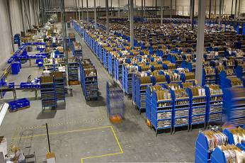
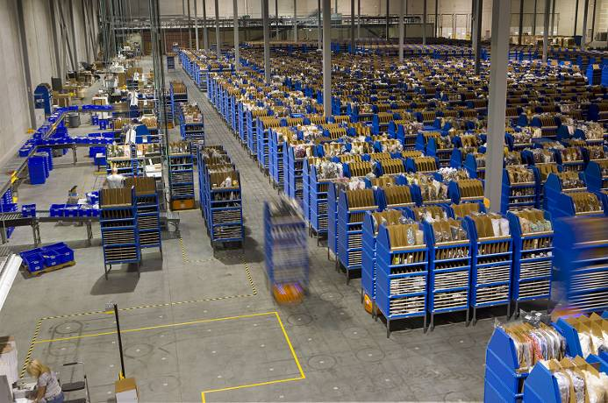

5-Megapixel High Resolution
1MP
5MP
2MP
Notes:
35

Slide 36

5-Megapixel High Resolution
Advantage
More details in the same FOV
Wider coverage in the same PPF
Benefit
Suitable for wide open areas
Suitable for detail monitoring
Notes:
36

Slide 37
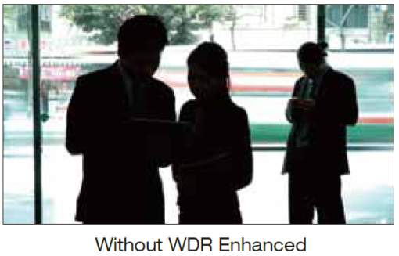
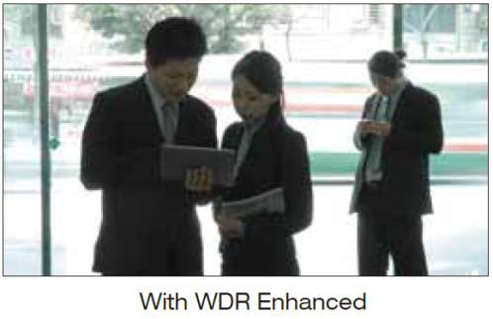

Product Benefit – WDR Enhanced
Advantage
Better visibility under high-contrast
scenes
Benefit
Ability to capture details under
challenging scenarios
(e.g. Entrance, Parking lot…)
Notes:
37

Slide 38
Smart Focus System
Advantage
Easier installation
Easy focal re-adjustment
More precise focus control
Benefit
Saving installation cost
Remotely FOV fine tuning at no cost
Better image quality
Notes:
38

Slide 39
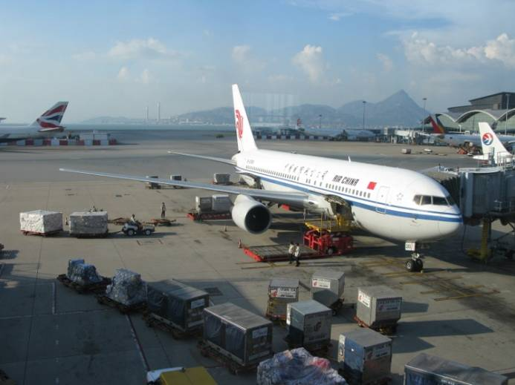
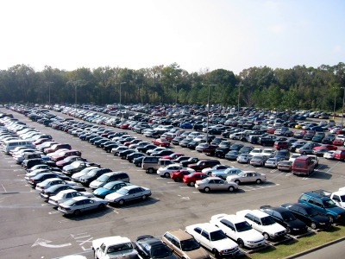
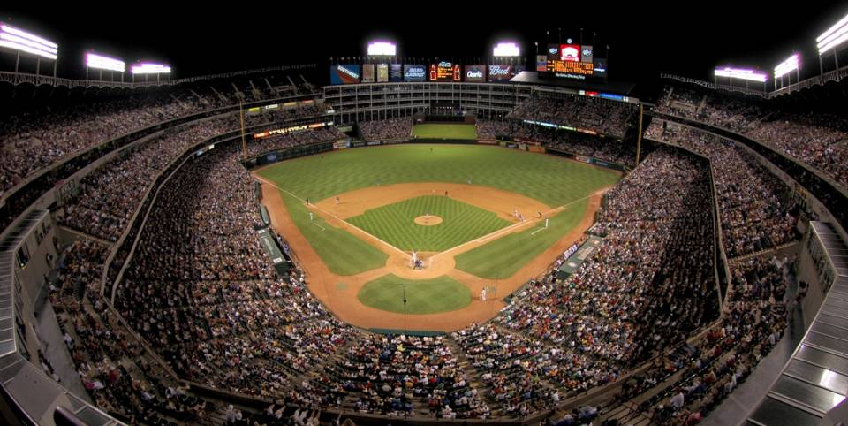
Applications
General viewing, wide coverage
  To watch for the presence of people and view their movements.

Slide 40
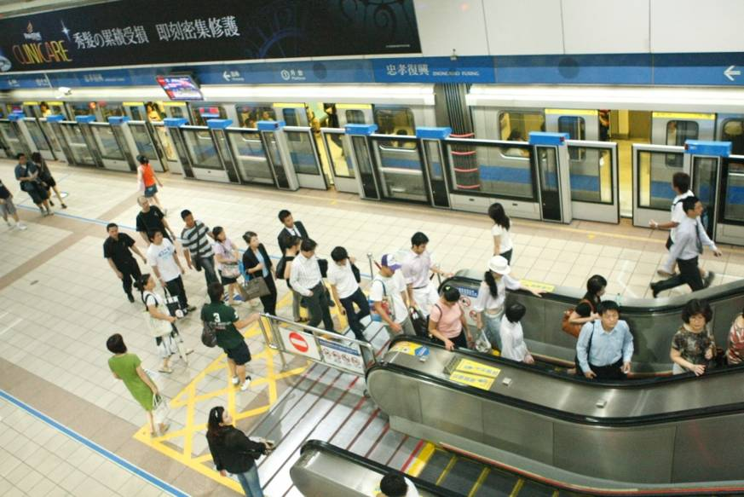
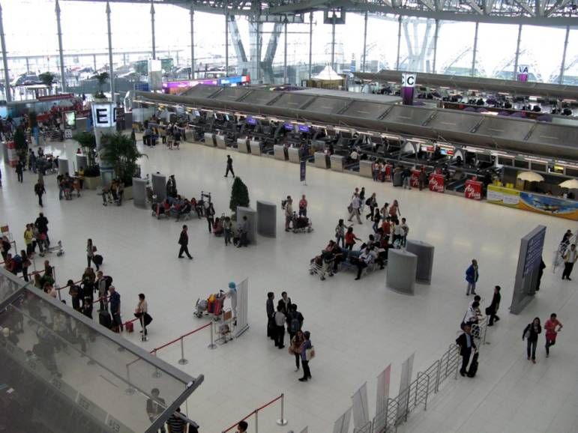
Applications
See every item, exceptional detail
  You need to be able to identify persons or objects in a scene.

Slide 41
FD8372 Information
Product page
  Datasheet
  User’s Manual
  Quick Guide
  http://www.vivotek.com/products/model.php?network_camera=fd8372
A&E Spec
  http://www.vivotek.com/support/ae.php

Slide 42
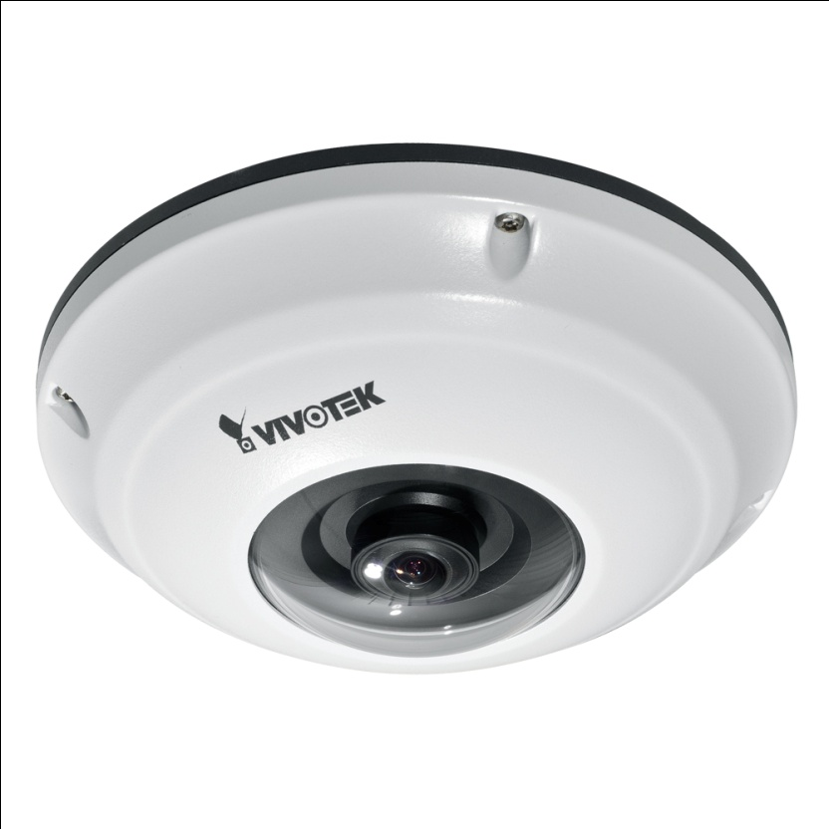
Product Feature, Advantage, Benefit
Product Position
Application Highlight
Product Comparison
Product Information
Q & A
Notes:
42

Slide 43

Product Features
3MP Resolution Sensor
1.27 mm Fisheye Lens
Built-in Microphone
True Day and Night Function
EN50155 Compliance
Vandal-proof IK 10 Rated
Weather-proof IP66-rated Housing
Micro SD/SDHC/SDXC
Triple Codec (H.264 / MPEG4 / MJPEG)
Multiple Stream
AC24v, DC12v, PoE
DI/DO: 1/1
ONVIF Support
36m Warranty
Notes:
43

Slide 44

FE8171V Selling Points
3MP Fisheye Camera
Built-in Microphone
SD/SDHC/SDXC Local Storage
IP66 rated Weather-proof
IK 10 rated Vandal-proof
EN50155 Compliant

Slide 45




Fisheye Introduction
360˚ Surround
180˚ Panorama
O
R
P
1O3R

Slide 46



360˚ Surround
Ceiling Mount or Floor Mount

Slide 47
360˚ Surround Demo
1O
1P
1R
2P
1O 3R
4R
1O 8R
Notes:
DEMO?

Slide 48


180˚ Panorama
Wall mount

Slide 49
180˚ Panorama
1O
1P
1R
1P 2R
1O 3R
1P 3R
4R
1O 8R

Slide 50
3MP Fisheye Network Camera
Panoramic View of the Whole Surveillance Area
Up to 8 VGA Cameras Cost and Installation Saving
No Mechanical Part And Maintenance Fee
High-capacity Local Storage Application
Benefits
Notes:
50

Slide 51
Built-in Microphone
Advantage
Provide audio from scene
Benefit
Save external microphone installation
and cost
Notes:
51

Slide 52


EN50155 certification
Advantage
Vibration resistant and cold start(-25 C)
Benefit
Mobile application (Inside or outside)
Notes:
52

Slide 53
Vandal-proof IK 10 Rated
Advantage
A. IK 10 rate vandal impact resistant
Benefit
Make camera more robust
More install locations
Notes:
53

Slide 54


Friendly ID Design
Advantage
Suitable for most of the indoor decoration
Benefit
Making comfortable environment
Notes:
54

Slide 55



Micro SD Card
Advantage
2TB
A. Local storage for system redundancy
B. Local storage to replace NVR
C. Local storage for seamless recording
Benefit
A1. Make system more reliable
A2. Save Bandwidth
B. Save NVR cost
C. Make system more robust
Notes:
55

Slide 56
Positioning Statement
FE8171V is open platform fisheye dome, providing H.264 streams with less bandwidth and storage consumption.
FE8171V is all in one design for IP66 and vandal proof without extra cost and installation fee.
FE8171V’s excellent de-warp performance could have fast ePTZ and more display mode than all other competitors
Notes:
56

Slide 57
5 Facts that FE8171V is better
1. Standard vs Proprietary
H.264 vs MxPEG
  Low bandwidth and storage
OnVif 1.02 ready
Easy to integrate
More VMS/CMS support
2. All in one
Compact size
IP66/Vandal proof
En50155
Built-ICR

Slide 58
5 Facts that FE8171V is better
3. Excellent de-warp performance
Smooth e-PTZ control
iPad/iPhone app ready
4. Rich display mode
Up to 8 display mode

Slide 59
5 Facts that FE8171V is better
5. Outstanding image quality
More detail for edge image
WDR enhancement
Gamma correction
Adaptive exposure window
Noise reduction in low light

Slide 60
2 Reasons of
not using image de-warp in camera
Whole view.
not only part image
Part image ( Camera de-warp)
It works only when right time on the right scene
Like speed dome without optical zoom
Original data is altered
Record original round image
Nothing is missing
Play around with ePTZ while playing back

Slide 61


Application Highlights
Commercial / Shopping mall
Airport / Rail Station
Notes:
61

Slide 62


Application Highlights
Education / Campus
City Surveillance / Sports and Leisure
Notes:
62

Slide 63

Application Highlights
Transportation
Notes:
63

Slide 64

Product Feature, Advantage, Benefit
Product Comparison
Product Information
Notes:
64

Slide 65
Product Features
Model | MD8562/62D
LENS | ．Board lens, Fixed, f = 2.8 mm, F2.0
CMOS sensor | ．1/2.7" CMOS sensor
Resolution | ．Up to 30fps@1920x1080
Video Codec | ．H.264/ MPEG-4/ MJPEG (Triple Codec)
Audio Capability | ．Audio in (Line in)
Streams | ．Multiple Stream
Digital I/O | ．1/0
Vandal Proof | ．IK10
Weather Proof | ．IP67
Local Storage | ．Micro SD/SDHC card slot
FOV | ．110° (horizontal) ．81.5° (vertical)
Power | ．DC 12V (MD8562D), PoE (MD8562)
Approvals | ．CE, LVD, FCC, VCCI, C-Tic, EN50155, UL(applying)
Notes:
65

Slide 66
MD7560 vs MD8562
Model | MD7560/60D | MD8562/62D
CMOS sensor | ．1/3.2" CMOS sensor | ．1/2.7" CMOS sensor
Resolution | ．Up to 15fps@1600x1200 | ．Up to 30fps@1920x1080
Video Codec | ．MPEG-4/ MJPEG (Dual Codec) | ．H.264/ MPEG-4/ MJPEG (Triple Codec)
FOV | ．98° (horizontal) ．73° (vertical) | ．110° (horizontal) ．81.5° (vertical)
Approvals | ．CE, LVD, FCC, VCCI, C-Tic, EN50155 | ．CE, LVD, FCC, VCCI, C-Tic, EN50155, UL(applying)
Notes:
66

Slide 67
Key Features
Easy Mobile Installation
Robust Design for Mobile Use
Easy Installation
Rugged Housing
Compact Size (107x130x47mm)
Vandal-Proof (IK10)
IP67 Weather-Proof
Enhanced
Reliability
Flexible
Power Capability
EN50155
(Cool/Heat/Surge/Vibration/Shock Test)
Operating Temperature -25℃~55 ℃
PoE Supported (MD8562)
DC12V Supported (MD8562D)
Advanced
Security
Local Storage
Audio input
1 channel Alarm input
Tamper Detection
Built-in Micro-SD/SDHC Card Slot for On-board Storage
Enhanced Security

Slide 68



Selling Points
1. Robust Design for Mobile Surveillance
Solid Mechanical Design
  Vandal-Proof
  IP-67 Weather-Proof
Enhanced Reliability
  -25℃~55 ℃
  EN50155
Cooling
Heating
Surge
Shock & Vibration

Slide 69

Selling Points
1. Robust Design for Mobile Surveillance
VIVOTEK Mobile Dome
Normal Mobile Dome
More Protection on the bubble (weak point)
No vandal protection on the bubble (weak point)

Slide 70



Selling Points
2. Easy to use – Flexible Power Adaptability
PoE (Power-over-Ethernet) Supported (MD8562)
PoE Switch
DC 12V Supported (MD8562D)
Direct Power Output from Mobile

Slide 71
Features
3. Enhanced Security
Additional Audio input & Alarm input
  Audio input
  1 channel Alarm input
Tamper Detection
  Detects and notifies users upon video loss from blockage or spray-painting
Local Storage
  Camera images are continuously recorded on the SD/SDHC card, the chance of data loss due to network disconnection is greatly reduced

Slide 72

Product Benefit – 2MP with Full HD
Notes:
72

Slide 73

Product Benefit – Wide View Angle
81.5°
110°
Notes:
73

Slide 74




Applications
Mobile Video Surveillance
Bus
Train
High Speed Rail
Robust Design for Mobile Surveillance
Vandal & Weather-Proof Housing
PoE & DC Power Supported

Slide 75
Product Feature, Advantage, Benefit
Product Comparison
Product Information
Notes:
75

Slide 76

Appendix – Package Contents
Note:
Power Adaptor is not included

Slide 77

Appendix – Physical Description

Slide 78

Web Page
http://www.vivotek.com/products/model.php?network_camera=md8562&tab=over

Slide 79

Market Status Report
Product Feature, Advantage, Benefit
Product Position
Application Highlight
Product Comparison
Product Information
Marketing Plan
FAQ
Notes:
79

Slide 80
Product Features
Full HD SONY CMOS Sensor
20x Zoom lens
Supports “WDR Pro” for Unparalleled Visibility in High Contrast Environments
Up to 60 fps @ 720p HD
Up to 30 fps @ 1080p Full HD
Audio Detection for Instant Alert
Built-in 802.3at Compliant PoE Plus
Built-in SD/SDHC Card Slot for On-board Storage
Weather-proof IP66 rated Housing
Wide Temperature Range for Extreme Weather Conditions
Notes:
80

Slide 81
Product Benefit –
2MP with Full HD & 20x Optical Zoom
Notes:
81

Slide 82
Product Benefit –
2MP with Full HD & 20x Optical Zoom
Advantages
Wide Coverage
Better details especially when
zoomed in
HDTV (16:9) compatible standard
Benefits
Compatible with Full HD TV or
high resolution LCD Monitors
Compatible with Full HD softwares
(e.g. Youtube HD)
SD8362E is equivalent to a
D1 45x analog speed dome
-- Better quality & Cost-saving!
Notes:
82

Slide 83


Product Benefit –
Extreme Weather-proof
(IP66 & -40℃~55 ℃ Operation Temperature)
Advantages
Ability to work in extremely cold
or hot areas
Ability to withstand pouring
water & dust
Benefits
Monitoring extremely hot areas
(e.g. Mines, Deserts, Power Generators…)
Monitoring extremely cold areas
(e.g. Arctic areas, Mountain areas…)
Notes:
83

Slide 84

Product Benefit –
WDR Enhanced & WDR Pro
With WDR Pro
Notes:
84

Slide 85
Product Benefit –
WDR Enhanced & WDR Pro
Advantage
Better visibility under high-contrast
scenes
Benefit
Ability to capture details under
challenging scenarios
(e.g. Entrance, Parking lot…)
Ability to capture details even when
facing lights
With WDR Pro
Notes:
85

Slide 86

Product Benefit –
Exceptional Frame Rate
(60 frames per second)
“Key Frame”
Notes:
86

Slide 87
Product Benefit –
Exceptional Frame Rate
Advantages
More frames captured in a time period
Ability to capture image during
pan/tilt movement
“Key Frame”
Benefits
Ability to capture more “Key frames”
Ability to capture details while
camera patrolling
Maintain 30fps under WDR Pro
Notes:
87

Slide 88




Product Benefit – Audio Detection
Email
Digital Output
ALARM!
Record
Notes:
88

Slide 89

Product Benefit – Audio Detection
The audio detection is two-way: above or under desired level
Trigger!
Audio alarm level
Trigger!
Current volume level
Notes:
89

Slide 90



Product Benefit – PoE Plus
Standard PoE
(802.3af compliant)
15 watts
Fixed Camera
Speed Domes
O
X
PoE Plus
(802.3at compliant)
30 watts
Fixed Camera
Speed Domes
O
O
Notes:
90

Slide 91
Positioning Statement
SD8362E is a professional Full HD speed dome specialized on clear video quality.
Unlike other 720p HD speed domes, SD8362E is equipped with Full HD with 20x optical zoom, bringing unparalleled image clarity.
With WDR Pro technology, SD8362E is more capable than others in high contrast areas, such as entrance, hallways, parking lots… etc.
Notes:
91

Slide 92
Market Status Report
Product Feature, Advantage, Benefit
Product Position
Application Highlight
Product Comparison
Product Information
Marketing Plan
FAQ
Notes:
92

Slide 93

Commercial
Value | Customer safety. Thief and Robbery Prevention. Crowd management
Location | Parking lot Halls
Features | Benefits
Full HD 20x zoom | Provide detail image for face recognition and license plate recognition.
WDR | Ability to monitor indoor & outdoor areas at the same time, especially important for entrances.
SD/SDHC recording | Save bandwidth System Redundancy
Notes:
93

Slide 94

Government
Value | People safety Thief and robbery prevention. .
Location | Sidewalk and road outside, outdoor facility
Features | Benefits
Full HD 20x zoom | Provide detail image for face recognition and license plate recognition.
WDR | Ability to monitor indoor & outdoor areas at the same time, especially important for entrances.
SD/SDHC recording | Save bandwidth System Redundancy
Notes:
94

Slide 95

Airports
Value | Airplane safety Customer safety. Anti-terrorism.
Location | Parking lot, open space of air port, airplane runway
Features | Benefits
Full HD 20x zoom | Provide detail image for face recognition and license plate recognition.
WDR | Ability to monitor indoor & outdoor areas at the same time, especially important for entrances.
SD/SDHC recording | Save bandwidth System Redundancy
Notes:
95

Slide 96

Ports
Value | Ship and payload safety Staff safety Secure property and facility SOP recording Anti-terrorism.
Location | Check point Working & storage area Port Facility
Features | Benefits
Full HD 20x zoom | Provide detail image for face recognition and license plate recognition.
WDR | Ability to monitor indoor & outdoor areas at the same time, especially important for entrances.
SD/SDHC recording | Save bandwidth System Redundancy
Notes:
96

Slide 97

Manufacturing and Industrial
Value | Factory safety. Production monitoring Transaction Behavior Secure property
Location | Building outside Manufacturing side
Features | Benefits
Full HD 20x zoom | Provide detail image for face recognition and license plate recognition.
WDR | Ability to monitor indoor & outdoor areas at the same time, especially important for entrances.
Audio Detection | Ability to detect production failure by change of sound.
Notes:
97

Slide 98

Casinos and Gaming
Value | Customer safety. Cheating presentation Face identification Thief and Robbery Prevention
Location | Gaming area Casino outside
Features | Benefits
Full HD 20x zoom | Provide detail image for face recognition and license plate recognition.
WDR | Ability to monitor indoor & outdoor areas at the same time, especially important for entrances.
Exceptional frame rate | Ability to catch “key frames” of gaming areas, where a lot of actions happens fast.
Notes:
98

Slide 99

City Surveillance
Value | Citizen’ life and property safety Anti-vandalism. Anti-terrorism Face and license plate identification
Location | Intersection Square Park
Features | Benefits
Full HD 20x zoom | Provide detail image for face recognition and license plate recognition.
WDR | Ability to monitor indoor & outdoor areas at the same time, especially important for entrances.
SD/SDHC recording | Save bandwidth System Redundancy
Notes:
99

Slide 100









WDR Pro
IP 8335H / FD8335H / FD8335H
P-Iris
Application
Resolution HD
WDR PRO
P-Iris
IP66

Slide 101


FD8136
2.5mm
6mm
Resolución HD
POE & Almacenamiento Local
Lentes de 2.5 / 3.6 / 6 mm
Instalación Fácil
3.6mm

Slide 102


VIVOTEK Helper

Slide 103

VIVOTEK Successful Story Center
http://www.vivotek.com/pressroom/success_stories.php?app=Airports&newlang=en

Slide 104
2012 H2 (Jul. ~ Dec.)
Notes:
104

Slide 105



FD8131
1-Megapixel
Vari-focal Mini-dome
Image sensor | 1/4” Progressive CMOS
Lens | Vari-focal
Video resolution | 30fps @ 1280x800
Day/Night | --
Audio capability | --
Local storage | Micro SD/SDHC/SDXC
PoE | Yes
Value-added features | Mini-size
<Reference Picture>

Slide 106

IP8361
2-Megapixel
Bullet Camera
Image sensor | 1/3” Progressive CMOS
Lens | Vari-focal
Video resolution | 15fps @ 1600x1200
Day/Night | Yes
Audio capability | Two-way audio
Local storage | SD/SDHC/SDXC
IR LED | 30 Meters
Value-added features | ePTZ

Slide 107



FE8172V
5-Megapixel
Fisheye Camera
Image sensor | 1/2.5” Progressive CMOS
Lens | Fisheye Lens f = 1.05mm
Video resolution | 12fps @ 1920x1920
Day/Night | Yes
Audio capability | Two way audio
Local storage | MicroSD/SDHC/SDXC
Weather-proof | IP66
PoE | Yes
Value-added features | ePTZ Vandal-proof EN50155 certification

Slide 108


5-Megapixel
(IP8172 / IP8372)
5-Megapixel
Box/Bullet Cameras
Image sensor | 1/2.5” Progressive CMOS
Lens | Vari-focal Remote Focus (IP8372)
Video resolution | 10 fps @ 2560x1920
Day/Night | Yes
IR LED | 25 Meters (IP8372)
Audio capability | Two way audio
Local storage | SD/SDHC/SDXC
PoE | Yes
Value-added features | ePTZ

Slide 109



IP8336W
1-Megapixel
Outdoor Wireless Cube Camera
Image sensor | 1/4” Progressive CMOS
Lens | Fixed focal f = 3.6mm
Video resolution | 1280x800 @ 30fps
Day/Night | Yes
Audio capability | Built-in Microphone
Local storage | Micro SD/SDHC
Weather-proof | IP66
Day/Night | Yes
IR illuminators | 5 Meters
Value-added features | ePTZ 802.11b/g/n Wifi WPS

Slide 110

PD8136
1-Megapixel
Pan/Tilt Dome Camera
Image sensor | 1/4” Progressive CMOS
Lens | Fixed focal
Video resolution | 30fps @1280x800
Day/Night | --
Audio capability | Built-in Microphone
Local storage | MicroSD/SDHC
Day/Night | ---
PoE | Yes
Value-added features | Mini-size Pan/Tilt functionalities

Slide 111

SD8331E / 32E
720p 20x/28x
Speed Domes
Image sensor | 1/2.8” Progressive CMOS
Lens | 20x Optical zoom 28x Optical zoom Auto-focus Auto-iris
Video resolution | 60fps @ 1280x720
Day/Night | Yes
Audio capability | Two way audio
Local storage | SD/SDHC/SDXC card slot
Weather-proof | IP66 NEMA 4X Wide temp. range (-40℃ ~ 55℃)
WDR type | WDR Pro
PoE | Yes (IEEE 802.3at PoE Plus)
Value-added features | 0.5º ~ 450º/s Pan/tilt speed 210º Tilt Angle Auto tracking
<Reference Picture>

Slide 112
SD8363E
1080p
Speed Dome
Image sensor | 1/2.8” Progressive CMOS
Lens | 1080p 36x zoom Auto-focus Auto-iris
Video resolution | 30fps @ 1920x1080 60fps @ 1280x720
Day/Night | Yes
Audio capability | Two way audio
Local storage | SD/SDHC/SDXC card slot
Weather-proof | IP66 NEMA 4X Wide temp. range (-40℃ ~ 55℃)
WDR type | WDR Pro
PoE | Yes (IEEE 802.3at PoE Plus)
Value-added features | 0.5º ~ 450º/s Pan/tilt speed 210º Tilt Angle Auto tracking
<Reference Picture>

Slide 113

FD8151V
1.3-Megapixel
Rugged Mini-dome
Image sensor | 1/3” Progressive CMOS
Lens | Fixed Focal f = 2.8mm
Video resolution | 1280x1024 @30fps
Day/Night | Yes
IR LED | 5 Meters
Audio capability | Built-in Microphone
Local storage | Micro SD/SDHC/SDXC
PoE | Yes
Value-added features | ePTZ Vandal-proof Ultra-mini size Supreme Night Visibility

Slide 114

IP8152
1.3-Megapixel
Mini-box Camera
Image sensor | 1/3” Progressive CMOS
Lens | Vari-focal Auto-iris
Video resolution | 30fps @ 1280x1024
Day/Night | Yes
Audio capability | Line-in
Local storage | MicroSD/SDHC/SDXC
PoE | Yes
Value-added features | Ultra-mini size Supreme Night Visibility
<Reference Picture>

Slide 115
IP8130 / IP8130W
IP8131 / IP8131W
1-Megapixel
Cube Camera
Image sensor | 1/4” Progressive CMOS
Lens | Fixed-focal
Video resolution | 30fps @ 1280x800
Day/Night | Yes (IP8131/31W)
IR LED | 8 Meters (IP8131/31W)
Audio capability | Built-in microphone
Local storage | SD/SDHC
PoE | Yes (IP8130)
Value-added features | 802.11b/g/n Wifi (IP8130/31W) WPS for easy setup (IP8130/31W)
Reference Picture

Slide 116

Thank you
for your attention
The End

